Slide 1
AI vs Human: Turning Sentiment Insights into an Engagement‑Boosting Allocation Playbook
200k Human + 300k AI Random Text
-> Distinct Sentiment Characteristics for AI/Human Generated Text
-> Auto AI Application Allocation
-> Increase Labor Efficiency & Foster Customer Experience
PROJECT SCOPE
DATESET OVERVIEW
METHODS

Slide 2
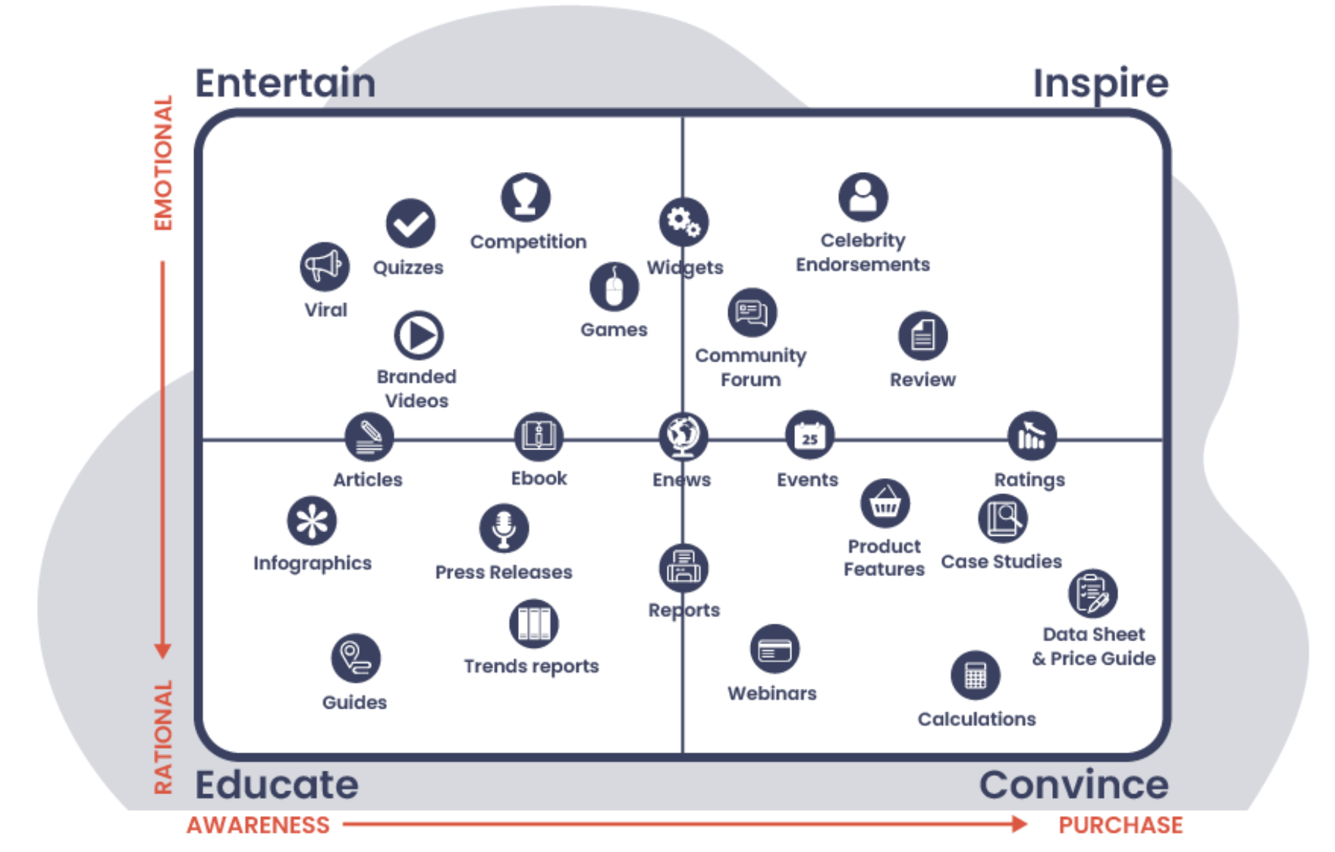
BALANCING AI EFFICIENCY WITH HUMAN AUTHENTICITY TO CUT COST AND BOOST ENGAGEMENT
A Framework to decide who should write what
AI assists Human | Human leads
Neutral Sentiment: Use AI Aid Human | High Sentiment: Human Primary
Low Sentiment: AI Primary | Neutral Sentiment: Use Human Aid AI
The content marketing matrix shows the diversified intentions of texts in business application, dividing by the energy levels and consumer’s awareness to purchase stage.
Using AI
Pros: High Speed/ Low Cost/ High Consistency/ Accurate at Statistics and Calculation
Cons: Robotics or Over-Furnished Tone / Factual Drift/ IP Concerns
Using Labor
Pros: Contextual Judgement/ Creative Originality/ Strategic Insight
Cons: High Cost/ Time Consuming/ Potential Bias
Determine optimal creator per quadrant to cut labor cost + while sustaining or improving engagement
Notes:
Project scope

Slide 3
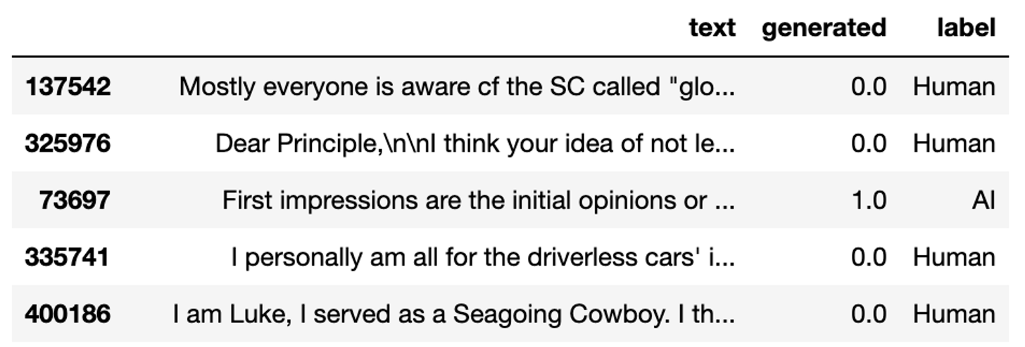
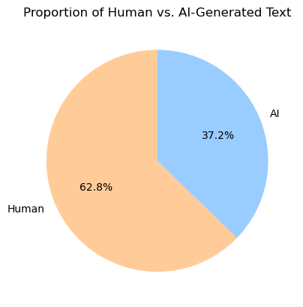
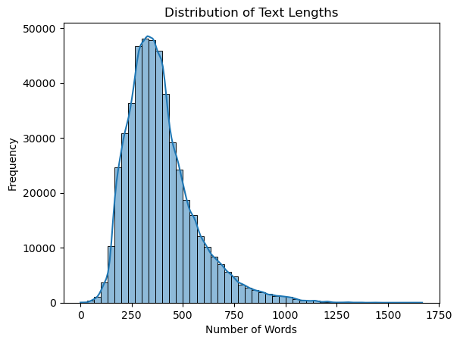
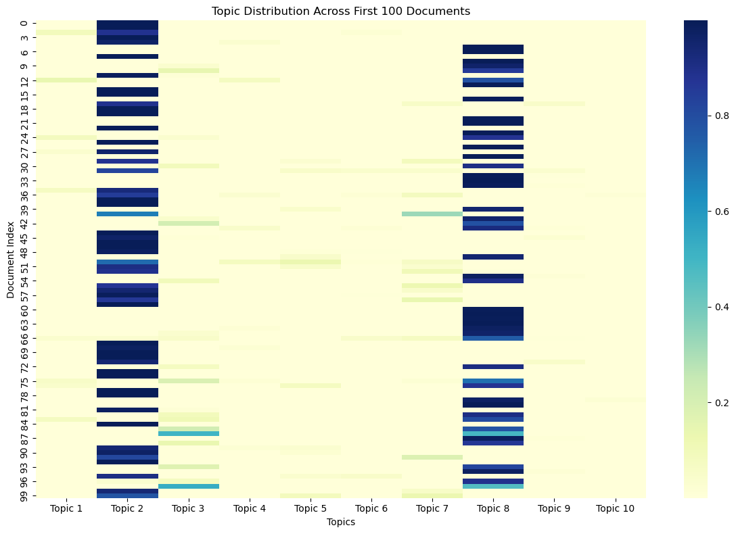
DATASET CHOSEN TO IDENTIFY WHERE AI OR HUMAN CONTENT BEST SERVES BRAND COMMUNICATION
Purpose-Aligned: Chosen to support our goal of determining when to use AI vs. human content to improve engagement, trust, and brand tone.
Balanced and Scalable: Human: 62.8%, AI: 37.2% — provides strong sample sizes for both categories without bias, suitable for LDA, N-gram, and Sentiment Analysis.
Labeled for Supervised Learning: Contains 487,235 rows of text, clearly labeled as AI-generated (1) or Human-written (0)—ideal for training classifiers and testing hypotheses.
Content Variety Matches Real Use Cases: Includes diverse writing samples with varied lengths, tones and topics, simulating real-world brand touchpoints (e.g., FAQs, emails, ads).
Method?
Data Source: https://www.kaggle.com/datasets/shanegerami/ai-vs-human-text
Notes:
Data Shortcomings
1. Sample Bias
The data may over-represent certain content types (e.g., marketing or support text), which might not generalize to all business use cases.
2. No Engagement Metrics
We don’t have labels like click rates, user reactions, or trust scores—so we can’t directly link text style to user behavior.
3. Binary Label Simplification
The dataset labels content as simply “AI” or “Human”, but in reality, there may be mixed/hybrid writing (e.g., AI-drafted, human-edited), which isn’t captured.

Slide 4
From Themes to Decision Rules: How the Model Routes 500 k Texts to AI or Humans
Topic Modelling – LDA
Style & Emotion Scoring
Quadrant Allocation Rule
Surface the most salient themes in AI vs Human
• Pre‑processing: bag‑of‑words (raw term‑count) matrix produced with a CountVectorizer after phrase‑detection for bigrams
• Model: Latent Dirichlet Allocation
• Comparison metric: Jensen–Shannon divergence on topic‑weight vectors → highlights themes (e.g., “Storytelling”) where Human share > AI share
• Output to next step: per‑document topic fingerprint
Quantify tonal differences that influence brand perception
• Sentiment Engine Based: VADER
• Pseudo‑labels from a zero‑shot LLM: Use Large Language Models to get the sentiment labels for our text
• Compare & collect errors
• Lexicon weight update: Add / re‑weight lexicon entries to fit our objective
Map each text onto Content‑Marketing Matrix and assign creator lead
• Axes: X = Energy (Emotional ↔ Rational), Y = Consumer Cognitive Load (Awareness ↔ Purchase)
• Find logistic Boundary: Regress style scores on the two CMM axes
• Decide Threshold to Map onto CMM

Slide 5
THANK YOU

